Slide 1
Object Oriented Programming using C++ Part I - Day 5

Slide 2
General Guideline
© (2008) Infosys Technologies Ltd.
This document contains valuable confidential and proprietary information of Infosys. Such confidential and proprietary information includes, amongst others, proprietary intellectual property which can be legally protected and commercialized. Such information is furnished herein for training purposes only. Except with the express prior written permission of Infosys, this document and the information contained herein may not be published, disclosed, or used for any other purpose.

Slide 3
Confidential Information
This Document is confidential to Infosys Technologies Limited. This document contains information and data that Infosys considers confidential and proprietary (“Confidential Information”).
Confidential Information includes, but is not limited to, the following:
  Corporate and Infrastructure information about Infosys
  Infosys’ project management and quality processes
  Project experiences provided included as illustrative case studies
Any disclosure of Confidential Information to, or use of it by a third party, will be damaging to Infosys.
Ownership of all Infosys Confidential Information, no matter in what media it resides, remains with Infosys.
Confidential information in this document shall not be disclosed, duplicated or used – in whole or in part – for any purpose other than reading without specific written permission of an authorized representative of Infosys.
This document also contains third party confidential and proprietary information. Such third party information has been included by Infosys after receiving due written permissions and authorizations from the party/ies. Such third party confidential and proprietary information shall not be disclosed, duplicated or used – in whole or in part – for any purpose other than reading without specific written permission of an authorized representative of Infosys.

Slide 4
Recap
‘Concept of big three ‘
Dynamic Memory Management
Two different ways of Object creation
Golden rules of memory management
Class relationship

Slide 5
Session plan – Day 5
Inheritance
Different types of Inheritance
Method Overriding
Base class pointers pointing to Derived class
Virtual Functions and Dynamic Binding
Abstract classes

Slide 6
Inheritance
Creating a new class from an already existing class is known as Inheritance.
The existing class is called as the base class ,super class or parent and the new class is called the derived, subclass or child class .
Through Inheritance, C++ strongly supports the idea of Reusability. That is making use of the existing features to create the new feature.
All the objects in this world come under some kind of classification. Inheritance allows the creation of hierarchical classification.
For example, the car “i20” is a kind of ‘Four Wheeler’ which is again a kind of ‘Vehicle’.
Notes:
Inheritance is process which allows a class Xyz to inherit properties of a class Abc To be more specific we can say that “Xyz inherits from Abc''. By this we are allowing the objects of class Xyz to access the data and methods of class Abc.
inheritance extends the concept if reusability. There is no need to write the class from scratch when we write a new program. We can use the existing class by simply specifying the inheritance relation between the two classes.
Base class is also called Super Class and Derived class is called Child class.
By using the concept of inheritance, it is possible to create a new class from an existing one and add new features to it.
It supports reusability.
Derived class shares common characteristics with the base class from which it is inherited .
Once the base class ‘Vehicle’ is defined with all general attributes, there is no need to redefine it once again in the derived classes.

Slide 7
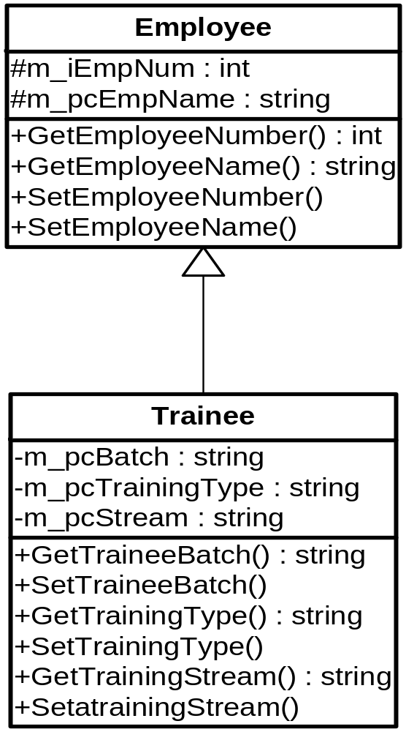
Inheritance – Generalization & Specialization
Generalization and Specialization are associated with the concept of Inheritance
The Trainee class derived from Employee class
Employee class is a generalization of Trainee class
Trainee class is a specialization of the Employee class
The relationship between Derived class and Base class is ‘Is-A’
Base/ Super/Parent Class
Derived/Child/ Sub Class

Slide 8
Inheritance – Protected Members
The ‘private’ members cannot be accessed outside the scope of the class.
The derived class also cannot access the private members.
Many a times , we want the child class to access the private members of the base class. But at the same time, we want that it should be in accessible to other classes or functions through the objects.
Those members come under protected access specifier.
In other words, protected members are private to all, but public to its derived classes.

Slide 9
Inheritance – Protected Members – Example
class Employee {
private:
int m_iEmpId;
protected:
float m_fBasic;
float m_fSal;
public:
void CalculateSal() { m_fSal=m_fBasic+.4*m_fBasic;
}
};
Class Trainee : public Employee{
private:
float m_fTPI;
public:
void CalculateTPI(char cGrade){
if(cGrade==‘A’) { m_fTPI=1200;
}else {
m_fTPI=900;
}
m_fSal=m_fBasic+m_fTPI;
printf(“%d%f”,m_iEmpID,m_fSal);
}
};
Valid
Invalid
Trainee oT1;
Employee oE1;
oE1.m_fBaisic // Invalid

Slide 10
Inheritance – Protected Members (Continued)
Advantages:
  Derived classes can modify values of members of base directly.
  It increases the performance.
  Set/get function call overhead is reduced
Disadvantages:
  Since derived class can access the members of base class there is no validity check , Derived class can assign illegal values
  Implementation dependent
    The implementation of derived class members is highly dependent on base class members.
    Any changes in Base class implementation may result in derived class modifications resulting in brittle software.

Slide 11
Inheritance – Types of Inheritance
In C++, Inheritance can be classified based on two aspects namely,
    Based on access Specifiers while deriving the classes
      Public Inheritance
      Private Inheritance
      Protected Inheritance
    Based on structure of classes
      Single Inheritance or Simple Inheritance
      Multiple Inheritance ( very rarely used)
      Multilevel Inheritance
      Hierarchical
      Hybrid Inheritance ( very rarely used)

Slide 12
Inheritance – Syntax
The general format of deriving the properties from class Xyz to class Abc is :
class <child-class-name> : [visibility-mode] <parent-classname>
{ // members of derived class
};
Visibility mode is optional and , if given can take values as either private or public or protected.
The default visibility mode is private.
The visibility of the base class members in derived class will be dependent on the visibility mode used while inheritance.

Slide 13
Types of Inheritance based on access specifiers – Examples
class Trainee : public Employee{
// class members
};
class Trainee : protected Employee{
// class members
};
Equivalent to Private Inheritance
class Trainee : Employee{
// class members
};

Slide 14
Inheritance – Public Inheritance
class Toshiba : public Laptop {
//Class Toshiba will inherit protected and public members //of Laptop with no change in access specifier
}
Laptop
Public Members
Protected Members
Private members
Toshiba
Public Members
Protected Members
Inherited – not accessible

Slide 15
Inheritance – Protected Inheritance
class Toshiba: protected Laptop {
//Class Toshiba will inherit protected and public members //of Laptop with public members getting prompted to //protected members
}
Laptop
Public Members
Protected Members
Private members
Toshiba
Protected Members
Protected Members
Inherited – not accessible

Slide 16
Inheritance – Private Inheritance
class Toshiba : private Laptop {
//Class Toshiba will inherit protected and public members //of Laptop with protected and public members getting //promoted to private
}
Laptop
Public Members
Protected Members
Private members
Toshiba
Private Members
Private Members
Inherited – not accessible

Slide 17
Inheritance - Summary
Type of Inheritance | Accessible inside Derived Class? i.e. In any of the methods of derived class |  |  | Accessible outside Derived Class? i.e. through derived class objects
 | Private member of Base class | Protected member of Base Class | Public member of Base class | Private member of Base class | Protected member of Base class | Public member of Base class
Private | NO | YES | YES | NO | NO | NO
Protected | NO | YES | YES | NO | NO | NO
Public | NO | YES | YES | NO | NO | YES

Slide 18
Inheritance - Example
class Employee {
private:
int m_iEmpId;
float m_fBasic;
float m_fSal;
public:
void CalculateSal() {
m_fSal=m_fBasic+.4*m_fBasic;
}
};
Class Trainee : public Employee {
private:
float m_fTPI;
public:
void CalculateTPI(char cGrade){
if(cGrade==‘A’) {
m_fTPI=1200;
}else {
m_fTPI=900;
}
}};
Employee oE1;
Trainee oT1;
oE1.CalculateTPI();//Invalid
oE1.CalculateSal(); //Valid
oT1.CalculateSal(); //Valid
oT1.CalculateTPI(); //Valid

Slide 19
Inheritance – Memory allocation for objects
class Employee {
private:
int m_iEmpId;
float m_fBasic;
float m_fSal;
public:
void CalculateSal() {
m_fSal=m_fBasic+.4*m_fBasic;
} };
Employee oE1;
m_iEmpId
m_fBasic
M_fSal
Trainee oT1;
Class Trainee : public Employee{
private:
float m_fTPI;
public:
void CalculateTPI(char cGrade){
//Code to calculate TPI
}};
m_iEmpId
m_fBasic
m_fSal
m_fTPI

Slide 20
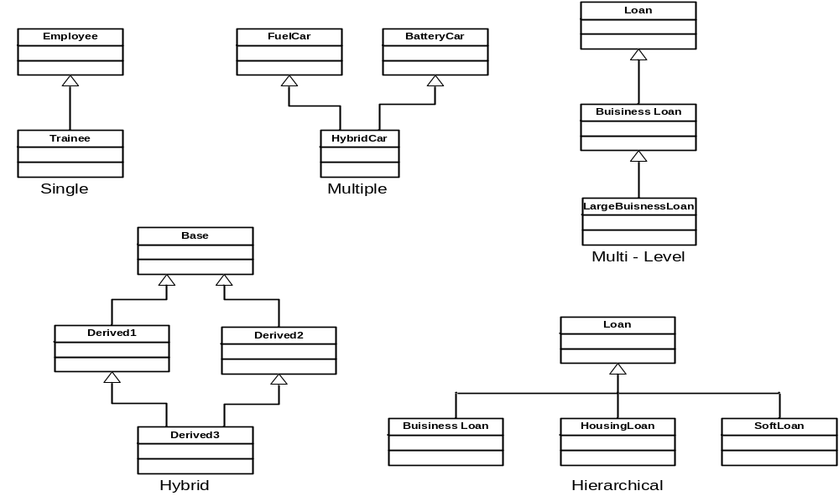
Inheritance Types – Based on structure
Rarely used

Slide 21
Inheritance – Constructors & Destructors
Constructors & Destructors are not inherited whatever may be the access specifier used.
When you create object of Derived, Base class default constructor is executed first and then derived class constructor is executed
If you want to execute a specific Base class constructor during derived class object creation, you can specify that in derived class constructor header.
Multiple inheritance executes base class constructors in the order they show in derived class declaration.
In case of multilevel inheritance, constructors are executed in the order of inheritance.
Destructors gets executed in the reverse fashion to constructors.
The derived class destructors is executed first and then the base class destructor is executed.

Slide 22
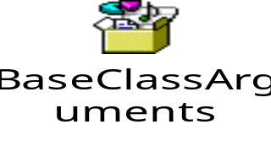
Inheritance – Constructors & Destructor
General syntax for calling base class constructor from derived class
<Derived class Constructor >:<Base Class Constructor>(parameters) {…}
class Employee {
private: int m_iEmpId; float m_fBasic, m_fSal;
public:
Employee(int iEmp,float fBasic,float m_fSal) {
// Base Constructor
}
};
Class Trainee : public Employee {
private:
float m_fTPI;
public:
Trainee(int iEmp,float fBasic,float fSal,float fTPI) : Employee(iEmp,fBasic,fSal) {
// Derived Constructor Definition
}
};

Slide 23
Test your understanding - Inheritance
Inheritance is a kind of …………..relationship.
There are …………. Types of inheritance.
We can public, private and ………. As access specifies.
Inheritance supports the idea of ………………
………. And …………. Inheritance are rarely used.
An object created for derived class will have memory for …………….. And ……………. Data members.

Slide 24
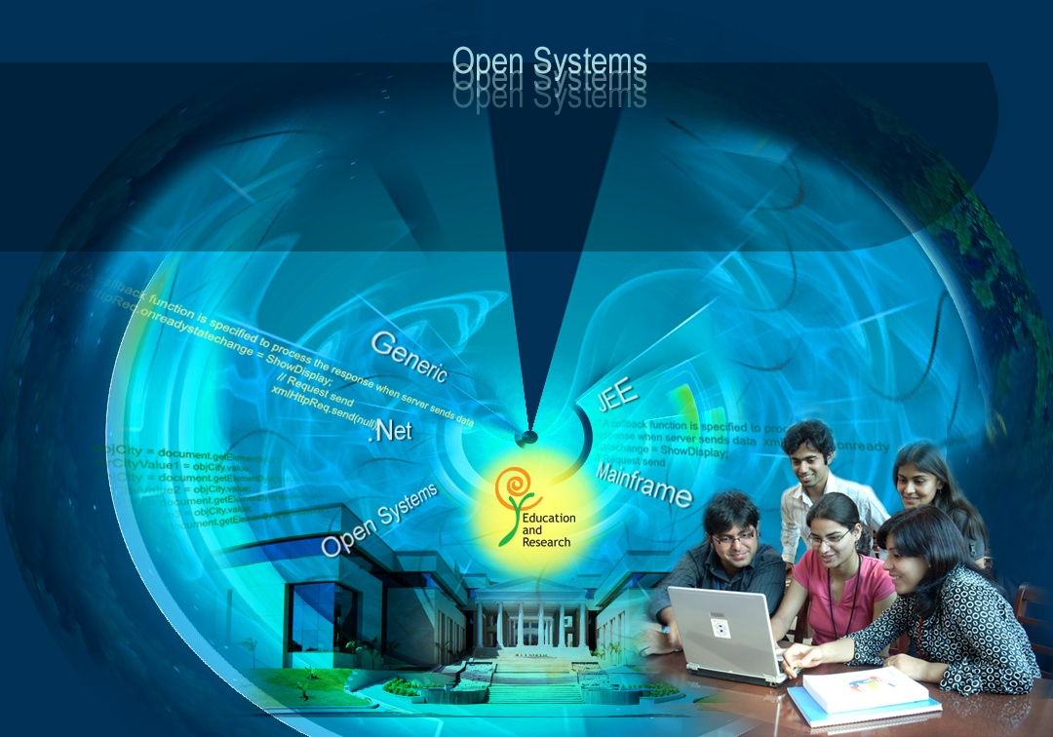
Education and Research
We enable you to leverage knowledge anytime, anywhere!
Multiple Inheritance and Virtual Functions
ER/CORP/CRS/LA1010/003
Ver. No.: 4.0
Confidential
Copyright © 2008, Infosys Technologies Ltd.

Slide 25

Multiple Inheritance - Problem
In case of multiple inheritance Ambiguity arises when the derived class has multiple copies of methods/functions inherited from the parent classes
The derived class will have two copies from base class data member one from Derived1 and other from Derived2
Baseclass
Derived1class
Derived2class
Derivedclass

Slide 26
Multiple inheritance - Example
class baseclass{
public:
int m_iData;
};
class derived1class:public baseclass{
public:
int m_iData1;
};
class derived2class:public baseclass{
public:
int m_iData2;
};
class derivedclass :public derived1class1,public derived2class{
public:
int m_iData3;
};
Which m_iData?
derivedclass ob;
ob.m_iData=10;//this is ambiguous, which m_iData?
Ob.derived1class::m_iData = 10; //ok

Slide 27

Multiple Inheritance
:: operator can be one way to resolve the ambiguity.
But if we want only one copy of base then we have to choose for some other solution i.e using virtual classes.
Virtual keyword makes sure that only one copy of base class members is available with the derived class even if the multiple copies are coming to it.

Slide 28
Virtual base class
class baseclass{
public:
int m_iData;
};
class derived1class : virtual public baseclass{
public:
int m_iData1;
};
class derived2class : virtual public baseclass{
public:
int m_iData2;
};
class derivedclass : public derived1class,public derived2class{
public:
int m_isum;
};
int main(){
derivedclass ob;
ob.m_iData=10;
ob.m_iData1=20;
ob.m_iData2=30;
return 0;
}
Notes:
By creating virtual functions in the base class, the derived class member functions can be accessed through the base class pointers. The decision to invoke the base class or the derived class member functions is done at run time (dynamically). This leads to dynamic binding.
When we used type casting to be able to point to the derived class, the binding was statically determined.

Slide 29
Virtual Base Class – Constructor and Destructor
Constructor and Destructor of base class will be invoked only once, if it is inherited virtually by it’s child classes
Super
Super
Child1:public Super
Child2:public Super
Child1:virtual public Base
Child2:virtual public Super
Child: public Child1,
public Child2
Child: public Child1,
public Child2
Constructor and Destructor call order:
Super, Child1,Super,Child2,Child
Constructor and Destructor call order:
Super, Child1,Child2 ,Child

Slide 30

Test your understanding?
class Super{
public:
Super(){
cout<<"Super"<<endl;
}
};
class Child1 : public Super{
public:
Child1(){
cout<<"Child1"<<endl;
}
};
class Child2 : public Super{
public:
Child2(){
cout<<“Child2"<<endl;
}
};
class Child : public Child1,public Child2{
public:
Child(){
cout<<“Child"<<endl;
}
};
int main(){
Child obj;
return 0;
}
Super
Child1
Super
Child2
Child

Slide 31
Test your understanding?
class Super{
public:
Super(){
cout<<"Super"<<endl;
}
};
class Child1 : virtual public Super{
public:
Child1(){
cout<<"Child1"<<endl;
}
};
class Child2 : virtual public Super{
public:
Child2 (){
cout<<" Child2 "<<endl;
}
};
class Child : public Child1,public Child2 {
public:
Child(){
cout<<“Child"<<endl;
}
};
int main(){
Child obj;
return 0;
}
Super
Child1
Child2
Child

Slide 32
Test your understanding?
class Super{
public:
~Super(){
cout<<"Super Destructor"<<endl;
}
};
class Child1 : public Super{
public:
~Child1(){
cout<<"Child1 Destructor"<<endl;
}
};
class Child2 : public Super{
public:
~Child2(){
cout<<“Child2 Destructor "<<endl;
}
};
class Child : public Child1,public Child2{
public:
~Child(){
cout<<“Child Destructor "<<endl;
}
};
int main(){
Child obj;
return 0;
}
Child Destructor
Child2 Destructor
Super Destructor
Child1 Destructor
Super Destructor

Slide 33
Test your understanding?
class Super{
public:
~Super(){
cout<<"Super Destructor"<<endl;
}
};
class Child1 : virtual public Super{
public:
~Child1(){
cout<<"Child1 Destructor"<<endl;
}
};
class Child2 : virtual public Super{
public:
~ Child2(){
cout<<" Child2 Destructor "<<endl;
}
};
class Child : public Child1,public Child2{
public:
~Child(){
cout<<“Child Destructor "<<endl;
}
};
int main(){
Child obj;
return 0;
}
Child Destructor
Child2 Destructor
Child1 Destructor
Super Destructor

Slide 34
Education and Research
We enable you to leverage knowledge anytime, anywhere!
Method Overriding
ER/CORP/CRS/LA1010/003
Ver. No.: 4.0
Confidential
Copyright © 2008, Infosys Technologies Ltd.

Slide 35
Method Overriding - Motivation
Is the way in which salary calculated for trainee exactly same as employee?
No
Hence, CalSal() method should be redefined in Trainee class with exact same method signature
This is called as method overriding
Employee
- m_iEmpId : int - m_fSal : float - m_fHRA : float
+ Employee() + CalSal: void
Trainee
- m_fTPI : float
+ Trainee() + CalSal() : void
Employee oEmp;
oEmp.CalSal();
Calls Employee version of CalSal()
Trainee oTrainee;
oTrainee.CalSal();
Calls Trainee version of CalSal()

Slide 36

Method Overriding
Redefining the methods in the derived class which is already defined in the parent class is called method overriding
When this method is invoked by derived class object, the method defined in the derived class gets executed
When this method is invoked by base class object, the method defined in the base class gets executed
Method overriding gives the programmer the flexibility to furnish the functionalities defined in the base class in derived classes

Slide 37
Method Overriding
class Employee {
protected:
int m_iEmpId;
float m_fSal,
float m_fHRA;
public:
Employee(){
m_iEmpId=1001;
m_fSal=200.29;
m_fHRA=1000;
}
void CalcSal() {
m_fSal=m_fHRA+120;
}
};
class Trainee :public Employee {
private:
float m_fTPI;
public:
Trainee(){
m_fTPI=18.8f;
}
void CalcSal() {
m_fSal=m_fHRA+m_fTPI;
}
};
Employee oE1;
Trainee oT1;
oE1.CalcSal()
oT1.CalcSal();

Slide 38

Virtual Functions - Motivation
Super class pointer can point to a sub class object.
class Employee {
protected:
int m_iEmpId;
float m_fSal,m_fHRA;
public:
void CalcSal() {
m_fSal=m_fHRA+120;
}
}
class Trainee :public Employee {
private:
float m_fTPI;
public:
void CalcSal() {
m_fSal=m_fHRA+m_fTPI;
}
}
Employee* poE1;
poE1= new Employee();
poE1->CalcSal();
Employee* poE2;
poE2= new Trainee();
poE2->CalcSal();
/*base class pointer type casted*/
((Trainee*)poE2)->CalcSal();

Slide 39
Virtual Functions – Dynamic Polymorphism
Base class pointer can invoke a method in the derived class without even without type casting.
This is done using the concept of virtual functions.
The following declares a virtual function:
virtual void CalcSal();
Employee * poE1 = new Trainee();
poE1->CalcSal();
This invokes the Trainee::CalcSal() using base class pointer.
Dynamic polymorphism is implemented with Virtual functions.
While accessing derived class object using base class pointer containing a virtual function, C++ compiler decides which method is to be invoked depending upon the type of the object pointed by the pointer.
Notes:
By creating virtual functions in the base class, the derived class member functions can be accessed through the base class pointers. The decision to invoke the base class or the derived class member functions is done at run time (dynamically). This leads to dynamic binding.
When we used type casting to be able to point to the derived class, the binding was statically determined.

Slide 40

Virtual Functions – Dynamic Polymorphism – Example
class Employee {
protected:
int m_iEmpId;
float m_fSal;
float m_fHRA;
public:
virtual void CalcSal() {
m_fSal=m_fHRA+120;
}
};
class Trainee :public Employee {
private:
float m_fTPI;
public:
void CalcSal() {
m_fSal=m_fHRA+m_fTPI;
}
};
Employee* poE1;
poE1= new Employee();
poE1->CalcSal();
Employee* poE1;
poE1= new Trainee();
poE1->CalcSal();

Slide 41
Education and Research
We enable you to leverage knowledge anytime, anywhere!
Virtual functions and base class reference.
ER/CORP/CRS/LA1010/003
Ver. No.: 4.0
Confidential
Copyright © 2008, Infosys Technologies Ltd.

Slide 42

Calling a virtual function through a Base class reference
Base class reference can be used to point to parent class itself or any other class inherited from it.
We use base class reference normally when the reference is a function parameter.
Works similar to the base class pointer.

Slide 43
Calling a virtual function through a Base class reference
class Employee{
public:
virtual void vfunc(){
cout<<"This is a Employee vfunc().\n";}
};
class Trainee:public Employee{
public:
void vfunc(){
cout<<"This is Trainee Employee vfunc().\n";}
};
class Interns:public Employee{
public:
void vfunc(){
cout<<"This is Interns Employee vfunc().\n";}
};
//function taking Employee class reference
void fnref(Employee &ref){
ref.vfunc();
}
void main(){
Employee ob1;
Trainee od1;Interns od2;
fnref (ob1);//pass a Employee object to f()
fnref (od1);// pass a Trainee object to f()
fnref (od2);// pass a Interns object to f()
}

Slide 44
Education and Research
We enable you to leverage knowledge anytime, anywhere!
Difference Between Static/Compile time and runtime/ Dynamic binding
ER/CORP/CRS/LA1010/003
Ver. No.: 4.0
Confidential
Copyright © 2008, Infosys Technologies Ltd.

Slide 45
Static Binding Vs Dynamic Binding
Static Binding | Dynamic Binding
Can be there in same class or parent child relationship | Can be in parent child relationship
within same class more than one method having same name but differing in signature | keeping the signature and return type same, method in the base class is redefined in the derived class
Resolved during compilation time | Resolved during run time
Return type is not part of method signature | Return type is part of method signature
Which method to be invoked is decided by the no, type or order of parameters | Which method to be invoked is decided by the object that the reference points to and not by the type of the reference
Function/Method/Operator Overloading or templates | Method Overriding
Notes:
(a polymorphic object is one that declares or inherits at least one virtual member function).

Slide 46
Education and Research
We enable you to leverage knowledge anytime, anywhere!
Virtual Destructors
ER/CORP/CRS/LA1010/003
Ver. No.: 4.0
Confidential
Copyright © 2008, Infosys Technologies Ltd.

Slide 47
Virtual Destructor - Motivation
A virtual destructor causes the complier to use dynamic binding when calling the destructor.
class Baseclass{
public:
~ Baseclass(){
cout<<"In baseclass destructor\n";
}
};
class Derived1class:public Baseclass{
public:
~ Derived1class(){
cout<<"In derived1class destructor\n";
}
};
int main(){
Baseclass *ptr1=new Derived1class;
delete ptr1;
return 0;
}
o/p In Baseclass destructor
Derived class destructor is not invoked leading to memory leaks.
Notes:
Only base class destructor is called making a memory leak for not destroying the derived class object.

Slide 48
Virtual Destructor Contd……
To avoid memory leaks ,destructor in base class has to made as Virtual.
class Baseclass{
public:
virtual ~ Baseclass(){
cout<<"In virtual Baseclass destructor\n";
}
};
class Derived1class:public Baseclass{
public:
~ Derived1class(){
cout<<"In virtual Derived1class destructor\n";
}
};
int main(){
Baseclass *ptr1=new Derived1class;
delete ptr1;
return 0;
}
o/p
In Derivedclass destructor
In Baseclass destructor
.
Notes:
e

Slide 49
Education and Research
We enable you to leverage knowledge anytime, anywhere!
Abstract Class and
Pure virtual functions
ER/CORP/CRS/LA1010/003
Ver. No.: 4.0
Confidential
Copyright © 2008, Infosys Technologies Ltd.

Slide 50
Inheritance – Abstract Class (Pure Virtual Function)
The virtual function with no definition in the base class is known as Pure Virtual function.
If a class contains at least one pure virtual function, that class is called as abstract class.
Derived Class should have the implementation of pure virtual functions . If not, derived class also will be an abstract class.
Instantiation of Abstract Class CAN NOT happen. i.e. object of abstract class cannot be created. However we can create pointers for it.
Generalization is the only purpose for creating Abstract classes i.e. It declares the prototype of collection of similar classes in the hierarchy of classes (Standard interface).
A general form of declaring pure virtual function is :
virtual <return-type> <function name> ( [argument-list ] ) = 0;
Notes:
In C++, if one class contains at least one pure virtual function( a virtual function is a function whose function body is equated to 0) it is called as abstract class.
Let us look at the body of the two methods defined above. We cannot initialize the variables called speed and color unless until it is not a specialized class and they are declared as virtual as well as equated to 0.
Defining some thing as Virtual When you say virtual ABC(..) = 0;, tells the compiler to let the derived class implement this method and provide a concrete behavior. After declaring a PURE virtual Function, we can NOT create the instances of the class.
Examples of Abstract classes: Shape, Vehicle, Fruit, Department.. etc

Slide 51
Abstract Class – Example
class Employee {
protected:
int m_iEmpId;
float m_fSal;
float m_fHRA;
public:
virtual void CalcSal() =0;
};
class Trainee :public Employee {
private:
float m_fTPI;
public:
void CalcSal() {
m_fSal=m_fHRA+m_fTPI;
}
};
Employee oE1; // Invalid
Employee* poE1;//Valid
poE1=new Employee();//Invalid
Employee* poE1;
poE1= new Trainee(); //Valid
poE1->CalcSal(); //Valid

Slide 52
Abstract Class vs. Interface
Interfaces can be declared using the Pure Virtual Functions, and they are meant to be inherited by concrete classes. Interfaces can NOT have any concrete member function and data.
class Shape { // An interface class
public:
~Shape(){};
virtual void draw() const = 0;
//...
};
class Circle : public Shape, public Rollable { // circles roll - concrete class
public:
void draw() const{cout<<"Implementing the circle class";}
void roll(){cout<<"abc";}
};
Notes:
Shape is an interface class

Slide 53

Capability Queries
Its used to check at runtime whether an object supports an interface or not.
It can be done by using dynamic_cast
  Dynamic_cast valides the casting at run time.
  Dynamic_cast<target-type>(expr)
    If casting fails then it returns NULL else expression is type casted to the target type.

Slide 54
Summary
Inheritance
Types of Inheritance
Various access specifies.
Multiple Inheritance and Virtual classes
Virtual Functions
Abstract classes and Interfaces.

Slide 55
Thank You
“The contents of this document are proprietary and confidential to Infosys Technologies Ltd. and may not be disclosed in whole or in part at any time, to any third party without the prior written consent of
Infosys Technologies Ltd.”
“© 2008 Infosys Technologies Ltd. All rights reserved. Copyright in the whole and any part of this document belongs to Infosys Technologies Ltd. This work may not be used, sold, transferred, adapted, abridged, copied or reproduced in whole or in part, in any manner or form, or in any media, without the prior written consent of Infosys Technologies Ltd.”

